Slide 1

Chapter 05- [2]
Extending bootstrap with JavaScript Plugin
Notes:
https://getbootstrap.com/docs/3.3/javascript/
https://getbootstrap.com/docs/4.0/getting-started/javascript/

Slide 2
Objectives
In this chapter, we'll go over how to use some of these components, including:
Coding a Modal dialog
Coding Tooltips
Using Popover components
Coding a Bootstrap Carousel
Notes:
In this chapter, we're going to dive deeper into Bootstrap components by learning how to extend the framework using JavaScript plugins. You may remember that back in the first chapter we included bootstrap.min.js in our template. This file contains a number of JavaScript components that come with Bootstrap. In this chapter, we'll go over how to use some of these components, including: Modals, Tooltips, Popovers, Collapse, and Carousel. Let's get right to it by learning how to create a Modal in Bootstrap 4.

Slide 3
Coding a Modal dialog
Notes:
Session: Ghi số thứ tự session trong môn học
Session Name: ghi tên của session sẽ dạy

Slide 4

Coding a Modal dialog
Modals go by a number of different names; you may also know them as dialogs, pop ups, overlays, or alerts.
A Modal is made up of two required pieces of code. The first is a button, and here's the basic code required to render it:
Notes:
The first is the data-toggle data attribute, which needs to be set to modal. This tells the browser that this <button> is attached to a Modal component.
The second is the data-target attribute, which should be an ID. It doesn't really matter what you name this, I've called it #firstModal. It's important to note this ID name as it will be tied in later. Also make sure that the ID name is unique.

Slide 5
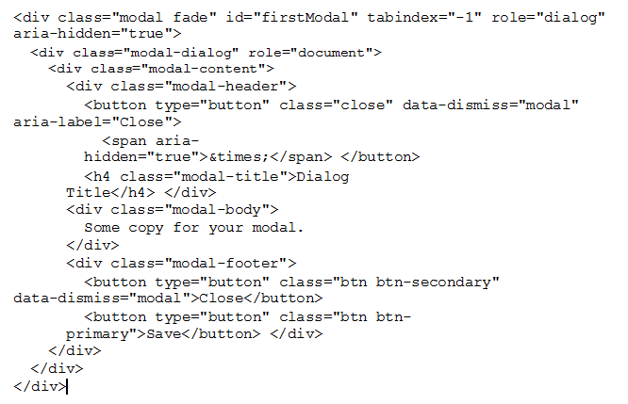
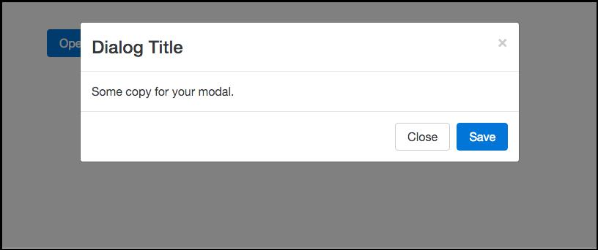
Coding the Modal dialog
Notes:
https://www.w3schools.com/bootstrap4/tryit.asp?filename=trybs_modal&stacked=h

Slide 6
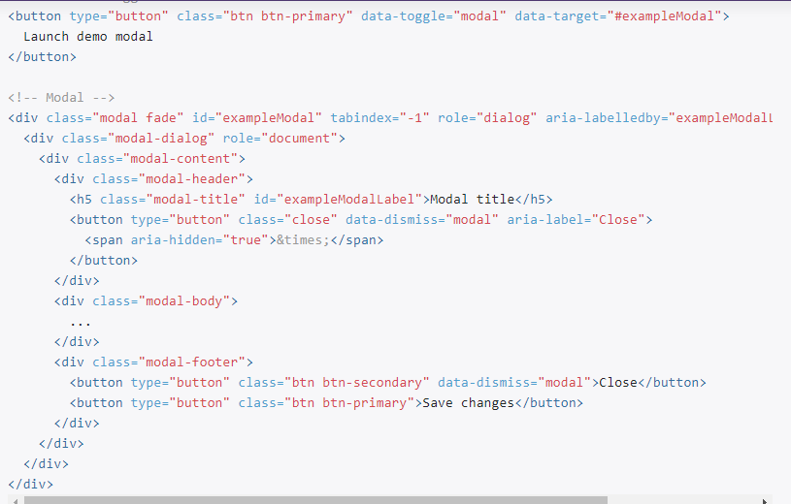
Coding the Modal dialog

Slide 7
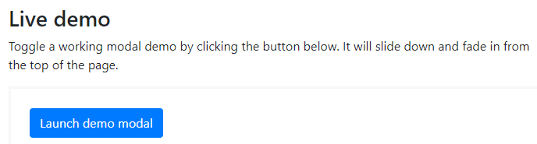
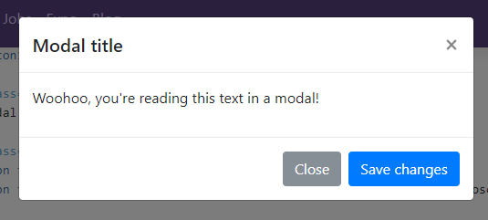
Coding the Modal dialog

Slide 8
Coding Tooltips
Notes:
Session: Ghi số thứ tự session trong môn học
Session Name: ghi tên của session sẽ dạy

Slide 9
Coding Tooltips
A Tooltip is a marker that will appear over a link when you hover over it in the browser. We do need to make some updates to get them working.
Before we go any further, head over to the Tether website below and download the library:
http://github.hubspot.com/tether/
Once you've downloaded the library, unzip it and open the main directory where you'll see a number of files (tether.min.js).
Now copy tether.min.js into the /js directory of our blog project
Notes:
They are pretty easy to add with data attributes in Bootstrap, but

Slide 10


How to use Tooltips
Notes:
https://www.w3schools.com/bootstrap4/tryit.asp?filename=trybs_tooltip&stacked=h

Slide 11
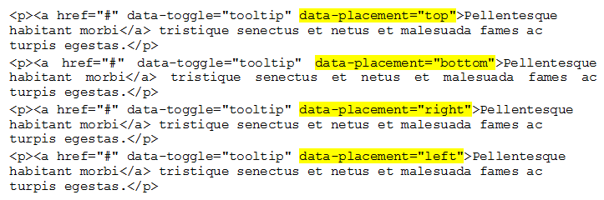
How to position Tooltips
Using the data-placement attribute will allow you to place the tip above, below, left, or right of the anchor text.
Notes:
https://www.w3schools.com/bootstrap4/tryit.asp?filename=trybs_tooltip_pos&stacked=h

Slide 12

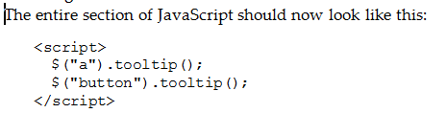

Adding Tooltips to buttons
It's also quite easy to add a Tooltip to a button by using the same data attributes as links.

Slide 13
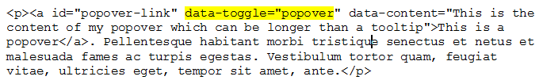

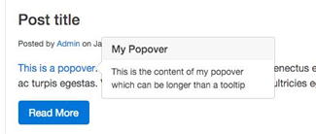
Using Popover components
Popover components are similar to Tooltips but allow for more content to be included.

Slide 14
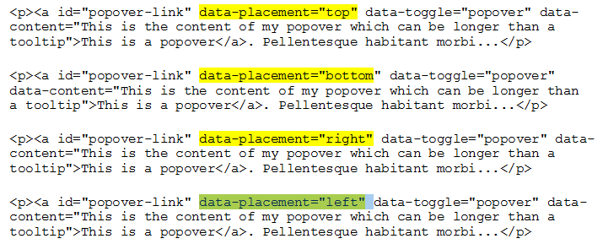
Positioning Popover components
Again, like Tooltips, it is possible to control the position of a Popover component. This is done in the same way by using the data-placement attribute on the link tag.

Slide 15
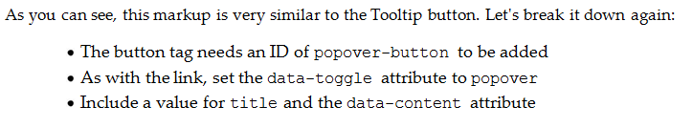
Adding a Popover to a button
A Popover component can also be easily added to a button.

Slide 16
Using the Collapse component
Add collapsible content easily with Bootstrap's .collapse and related classes.
You can make your content collapsible by adding data-toggle="collapse" to either a button or a hyperlink.
Notes:
https://www.quackit.com/bootstrap/bootstrap_4/tutorial/bootstrap_collapse.cfm

Slide 17
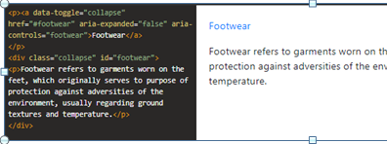
Using the Collapse component
Using a Link : Use the <a> tag with an href value of the ID of the content to collapse. On the collapsible content container, add the .collapse class, and be sure to give it an ID.

Slide 18
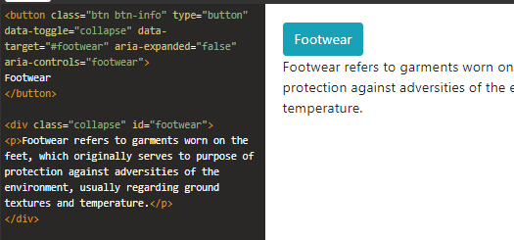
Using the Collapse component
Using a Button: Use the data-target attribute with a value of the ID of the content to collapse. On the collapsible content container, add the .collapse class, and be sure to give it an ID

Slide 19
Coding a Bootstrap Carousel
https://www.w3schools.com/bootstrap4/bootstrap_carousel.asp
Notes:
https://www.w3schools.com/bootstrap4/bootstrap_carousel.asp

Slide 20
Bootstrap Carousel
Carousel is a popular component used on many different types of websites.
The Carousel component starts with a <div> and it needs a unique ID. In this case, #carouselOne. Also include the following classes: .carousel and .slide.
Finally, you need to add the attribute data-ride with a value of carousel.
Notes:
https://www.quackit.com/bootstrap/bootstrap_4/tutorial/bootstrap_carousel.cfm

Slide 21
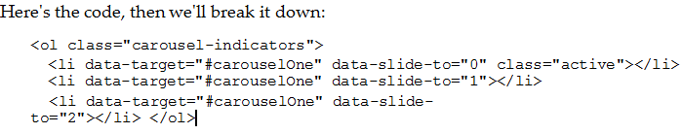
Adding the Carousel bullet navigation
The first thing we need to add to the Carousel is the bullet or indicator navigation. It's made up of an ordered list

Slide 22
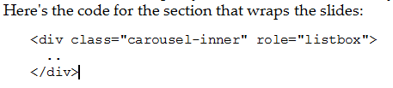
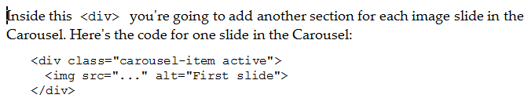
Including Carousel slides
The next step is to include the actual Carousel slides. I'm not going to include images in the code, that will be up to you to insert.

Slide 23
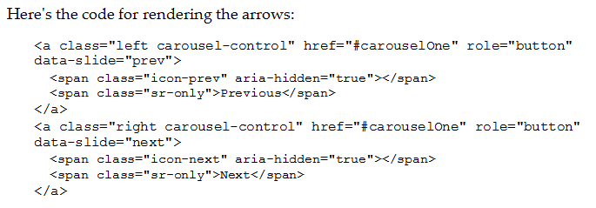
Adding Carousel arrow navigation
The last thing we need to add to the Carousel is the arrow navigation.

Slide 24
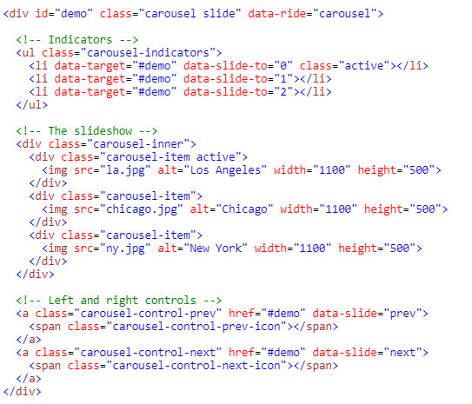
Demo Carousel
Notes:
https://www.w3schools.com/bootstrap4/tryit.asp?filename=trybs_carousel

Slide 25
Summary
In this chapter, we have covered all components in Bootstrap that rely on JavaScript.
This included:
Modals
Tooltips
Popovers
Collapse
and Carousel.
Notes:
Tóm tắt lại nội dung đã học

